Slide 1

Get A Doc A Doctor Appointment Application
By Upayan Chakraborty (CSE/22/002)

Slide 2

About the Project
The Doctor Appointment Application is a simple web-based system designed to manage doctor-patient appointments efficiently.
It allows users to add doctors and patients and schedule appointments between them.
The system helps reduce manual paperwork and improves organization in clinics or small hospitals.

Slide 3

Features
Add new doctor details with name, specialization, and availability.
Add new patient details with name, age, and contact.
Schedule appointments by selecting doctor and patient along with date/time.
Simple and user-friendly interface.
Basic validation to avoid scheduling conflicts.

Slide 4
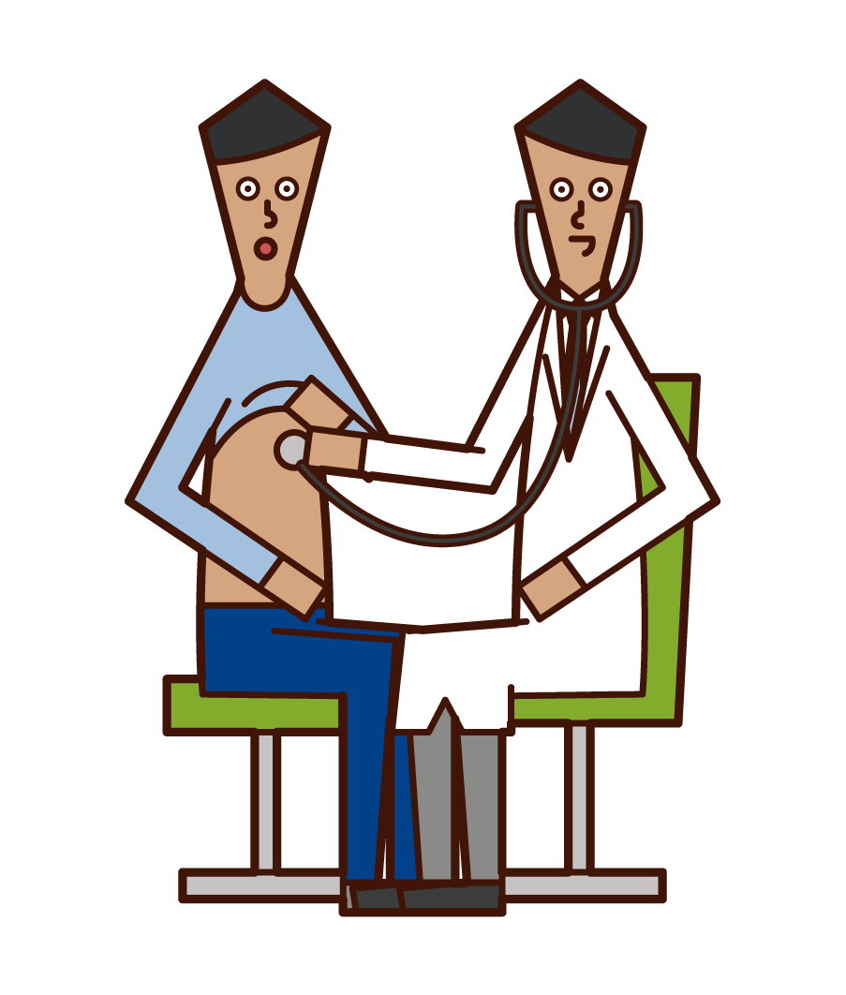
Module Description
Doctor Module: Add new doctors with details like name, specialization, and timings.
Patient Module: Add patient details such as name, age, gender, and contact number.
Appointment Module: Schedule an appointment by selecting doctor and patient. Check and avoid double-booking.

Slide 5

Software and Hardware Requirements
Software Requirements:
Frontend: HTML/CSS/JavaScript or any GUI framework
Backend: Springboot
Database: PostgreSQL
Hardware Requirements:
Processor: 1.6 GHz or above
RAM: Minimum 2 GB
Hard Disk: Minimum 500 MB of free space

Slide 6
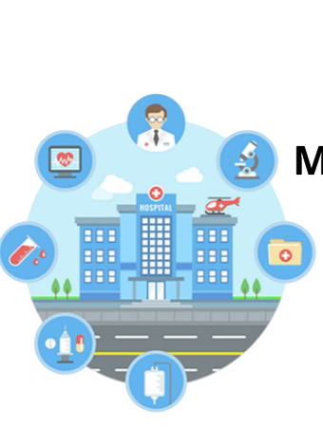
Problem Solving
Existing Problem: Manual appointment scheduling is error-prone and inefficient.
Our Solution: This app simplifies scheduling and ensures proper time management between doctors and patients.
Impact: Reduces human error, avoids overlapping appointments, and saves administrative time.

Slide 7

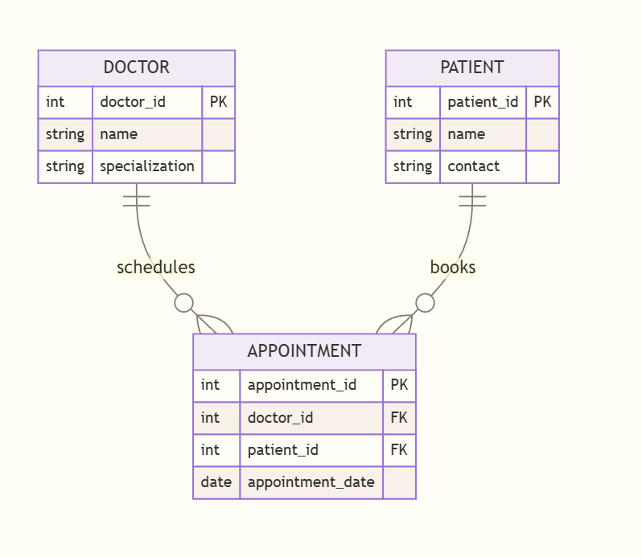
Entity Relationship Diagram

Slide 8
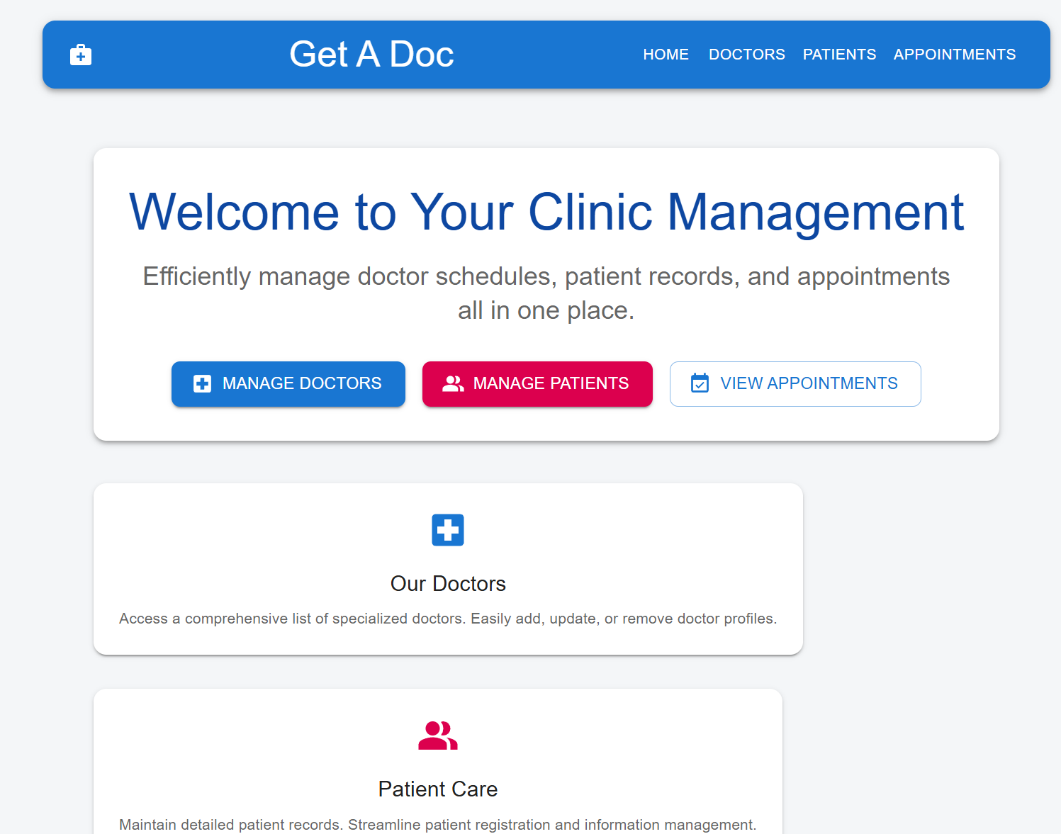
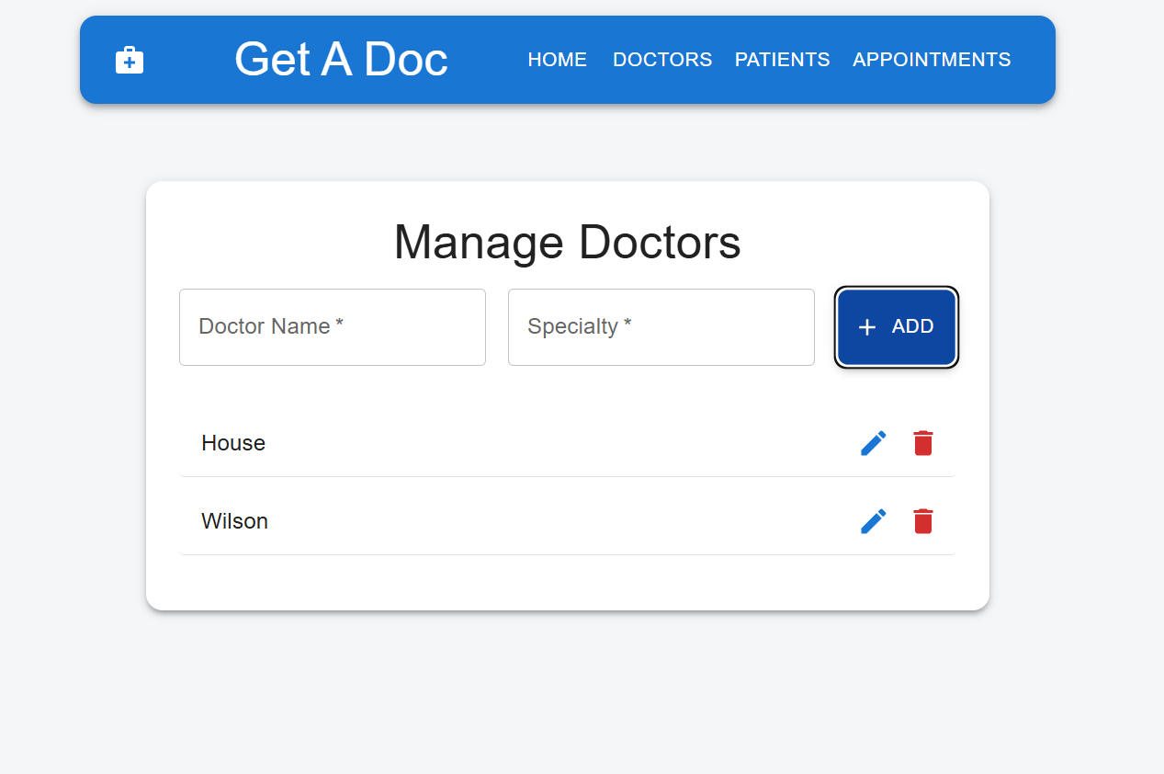
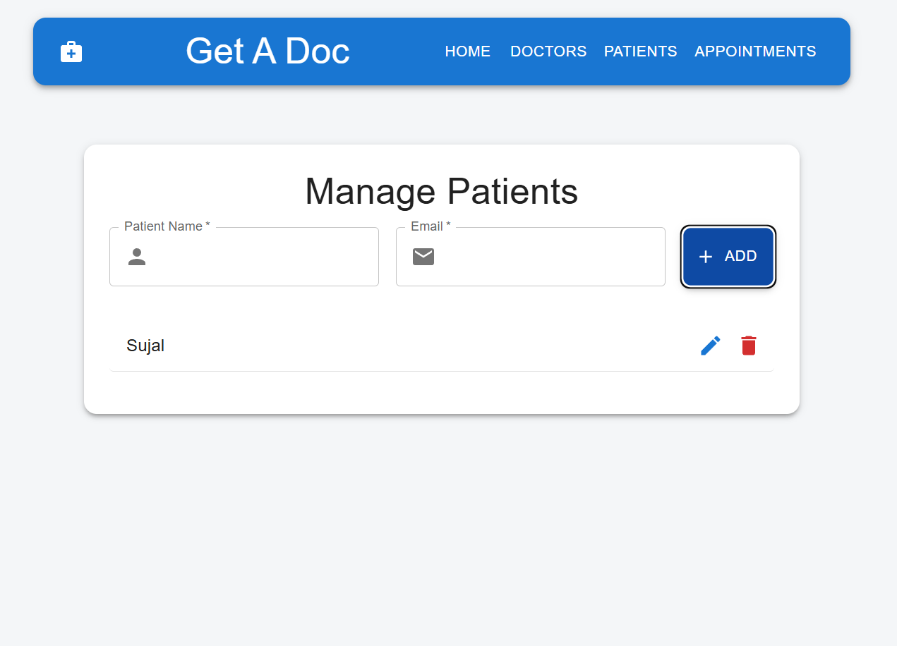


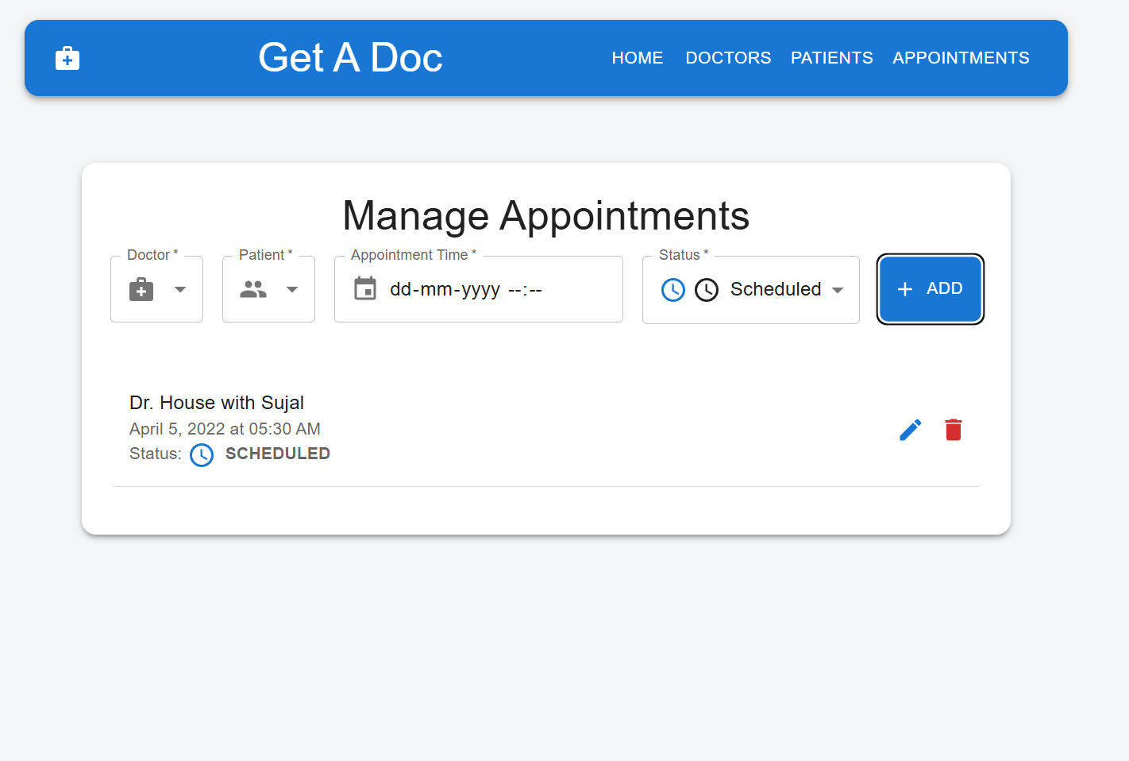
Input And Output Screen

Slide 9



Thank You

